Slide 1
Workshopped Plays in a South African Correction Centre: Negotiating Social Relations Through Theatre
Appendix 6: Video Clips
Source: Hurst, Christopher. 2002. Rehearsals for Isikhathi Sewashi. Unpublished.
Hurst, Christopher. 2002. Rehearsals for Liselhon’ Ithemba. Unpublished.
Hurst, Christopher. 2003. Isikhathi Sewashi Performed for Com Tech
Secondary School. Unpublished.
Click on each image to play

Slide 2
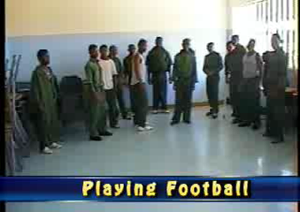
Clip 1: Building the Play Using Image Theatre/Core Images
P126

Slide 3
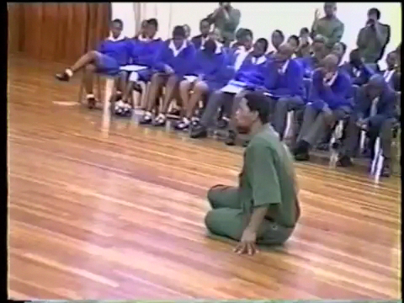
Clip 2: An offender plays MaVilikazi: Gesture, Gestus and Core-images
P134
MaVilikazi complains about her daughter wearing a short skirt

Slide 4
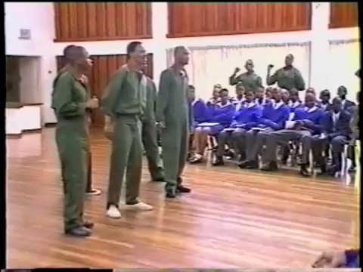
Clip 3: Tableaux That comment on the scene being played p140

Slide 5
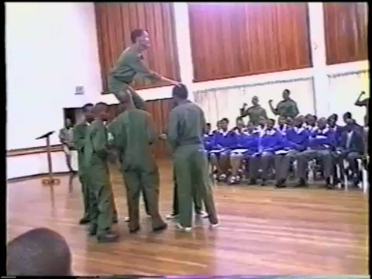
Clip 4: Nkululeko leaving the country to join Umkhonto we Sizwe p140

Slide 6
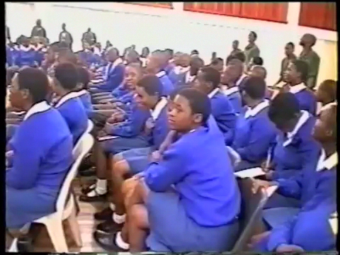
Clip 5: a famous protest song from the 1980s titled Release Mandela p140

Slide 7
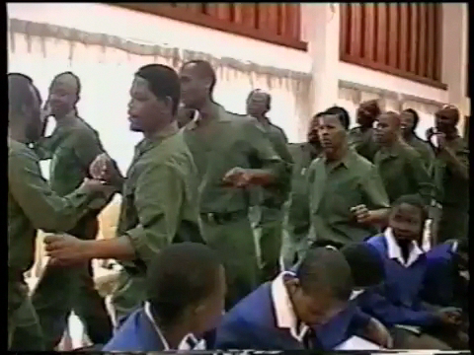
Clip 6: IFP Song p143

Slide 8
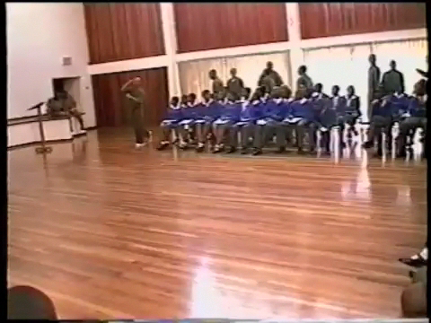
Clip: 7 ANC Song p143

Slide 9
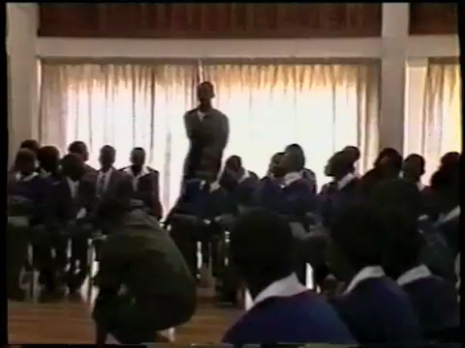
Clip 8: three characters speak to the audience about their memories of the 1980s p143

Slide 10
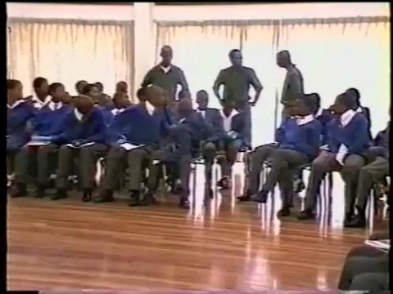
Clip 9: The consequences of the murdering the Guard p143

Slide 11
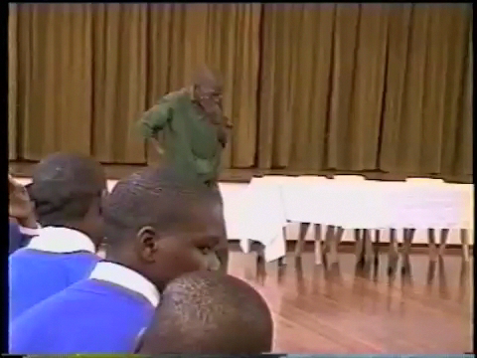
Clip 10: An ex-offender remembers prison and rejects crime p146

Slide 12
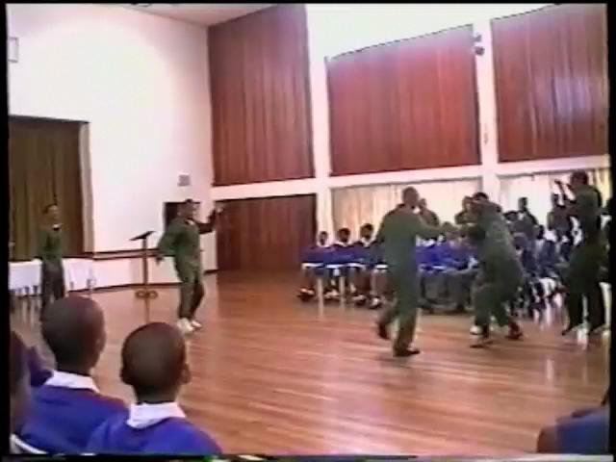
Clip 11: A man wearing a sandwich-board. The slogans commented on the action p146

Slide 13
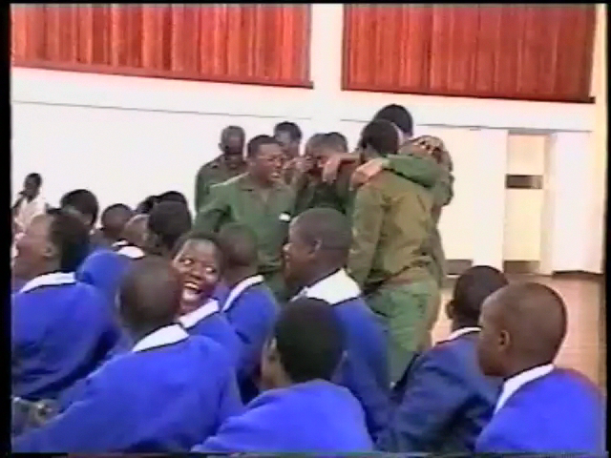
Clip 12: A man wearing a sandwich-board. The slogans commented on the action p146

Slide 14
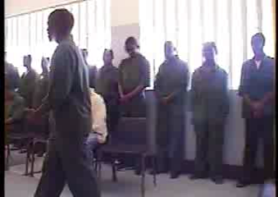
Clip 13: Popular African Performance forms: Isicathamiya (Accapella singing) p146
“We grew up together,
We are not equal.
People being not the same.
Living together.”

Slide 15
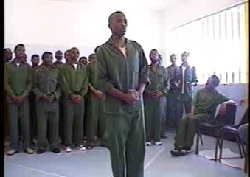
Clip 14: Popular African Performance forms: Izimbongo ( Praise poetry) p146
“Apartheid
I am scared of you apartheid
And you civilisation
Civilisation, this propaganda that arrived with
Those who the sun shines through their ears
You're like a hyena that covers itself with skin of the sheep
In the house of the Blacks
You have separated me from my culture and my humanity
I am like meat nobody wants to eat in my own country
You have injured me psychologically
Because of me, my people are in anguish
Bhu! Following you civilisation
With your glitter that is still here today
And when we were sleeping and waking doing crime,
Drugs, and violence. You asked us if
We still know who we are. It was silent
Wake up Africa! Up until when,
Will you be the spoil of criminals
Get out of the fog of looking down on yourself
Let's go back to our roots Mother Africans.”

Slide 16
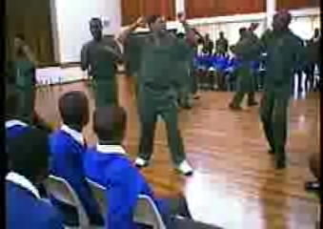
Clip 15: Popular African Performance forms: Izingoma Neziqubulo of The Amabutho p146
“Leader: Hebe[1]!
Group: Usuthu![2]
Leader: Hebe!
Group: Usuthu!
Leader: Down with UDF down
Group: Down
Leader: Down with youth down
Group: Down
Leader: Forward with Shenge[3] forward
Group: Forward”
[1] Hebe is a isiZulu warning call.
[2] Usuthu is an alternative word for Zulu people derived from the name for an ancient king’s palace called Osuthu.
[3] Shenge is a praise name for Buthelezi.

Slide 17
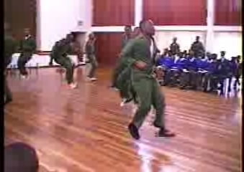
Clip 16: Popular African Performance forms: Toyi-toyi (protest Songs) p146
“Leader: They are killing
Chorus: They are killing our parents
While we are still young.
All over the country
They rule with the gun”

Slide 18
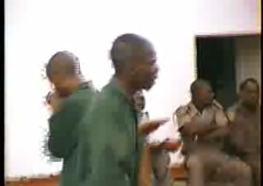
Clip 16: Popular African Performance forms: Kwiato ( IsiZulu rap) p146
Thug: Taking this opportunity to release all my in-depth thinking
When the magistrate gave me a long sentence in prison
Time has passed me by, I am from prison
I hope you will listen to me and do as I do
I am a dreamer keep on dreaming everyday
Telling myself that one day I will be the one
Who is stopping violence and crime in this World
Time of the watch has passed me by, never again
People are fighting, pointing guns to one another
Death rate cycle of crime is 90%
Brothers now is the time life has really changed
Time of the watch has arrived, after all we have got the message
We’ve got the White man with the cast against crime
Chorus: It’s the time of the watch
Well we are all getting you

Slide 19
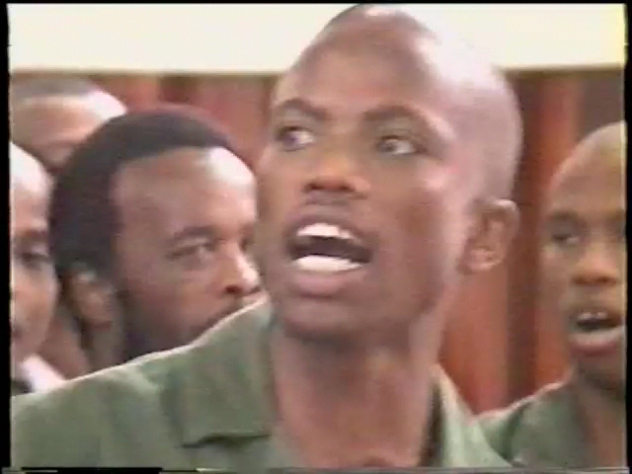
Clip 18: Opening Song p146
Leader:We grew up together
We were not equal
People being not the same
Living together
Chorus: We grew up together
We were not equal
People being not the same
Living together

Slide 20
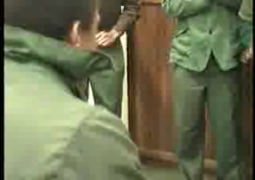
Clip 19: the audience warm-up using Ngoma dance p153

Slide 21
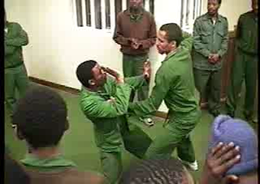
Clip 20: The audience discuss using image theatre p157

